Slide 1
FlyFiler
Presented by,
Rupali Tasnim Samad
60914
Supervised by,
Dr. B M Mainul Hossain
Associate Professor, IIT DU

Slide 2
What is FlyFiler?
Register and
Login
File Management System
Main Menu to Choose
Operations
Text file
Compression
Decompression
Text file Encryption
Decryption

Slide 3
Algorithms Implemented for this project
Advanced Encryption Standard – AES
Data Encryption Standard – DES
Huffman Algorithm

Slide 4
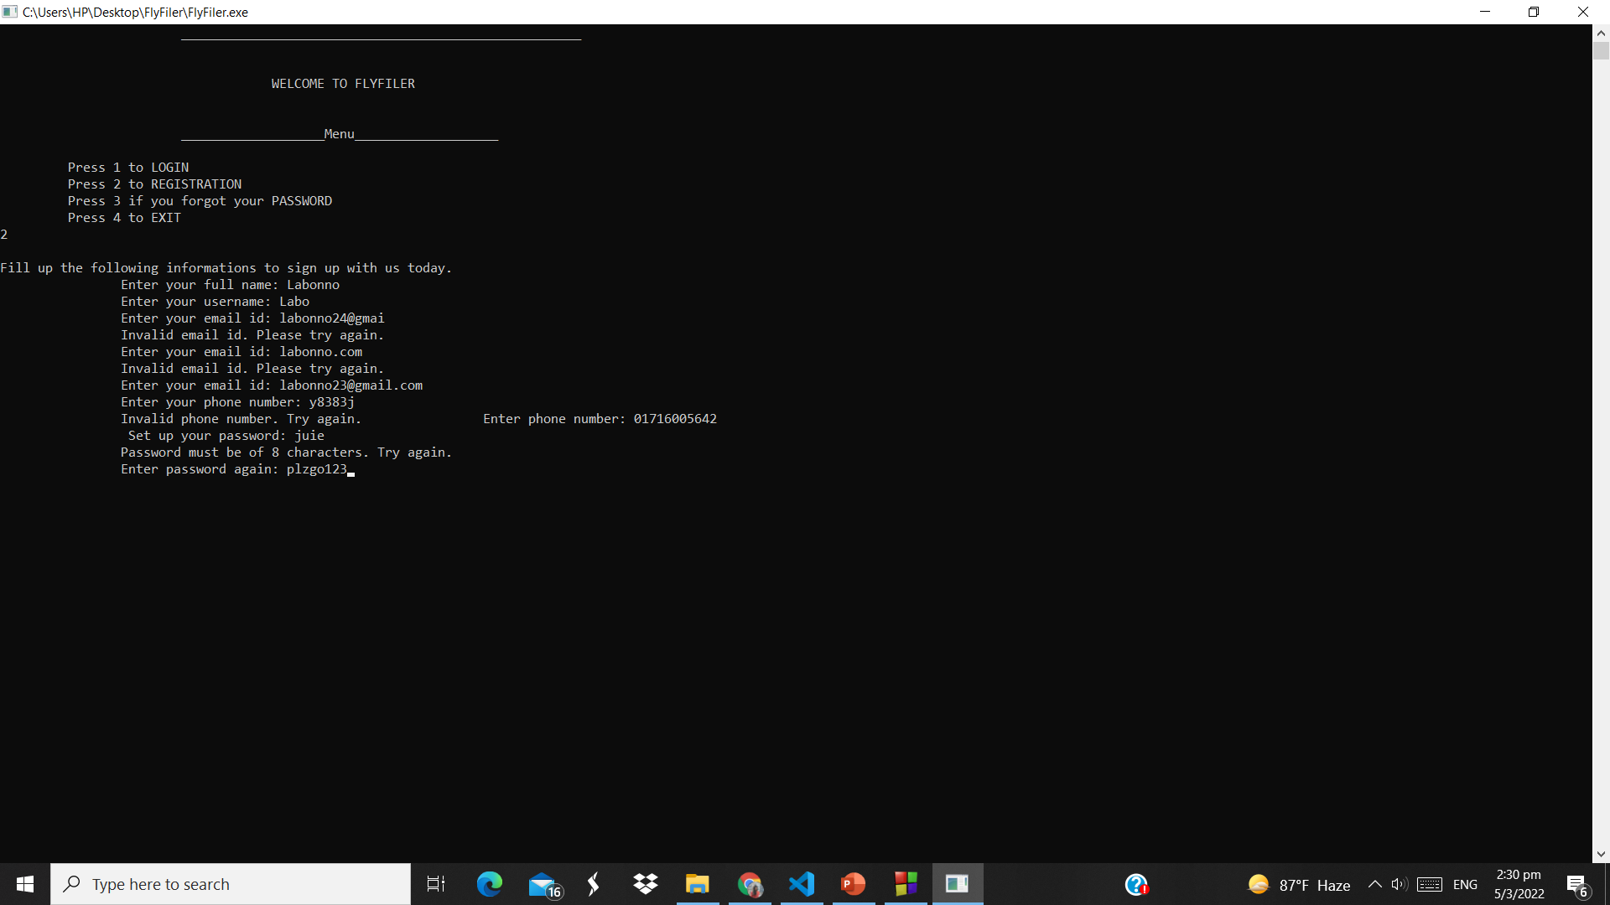
Menu
Registration

Slide 5
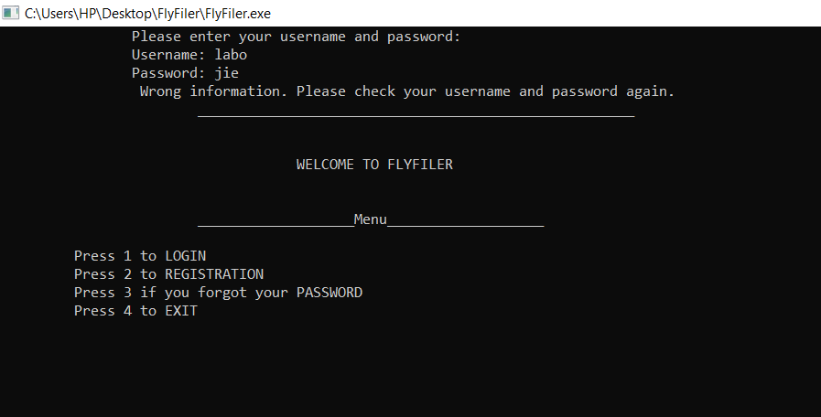



Slide 6
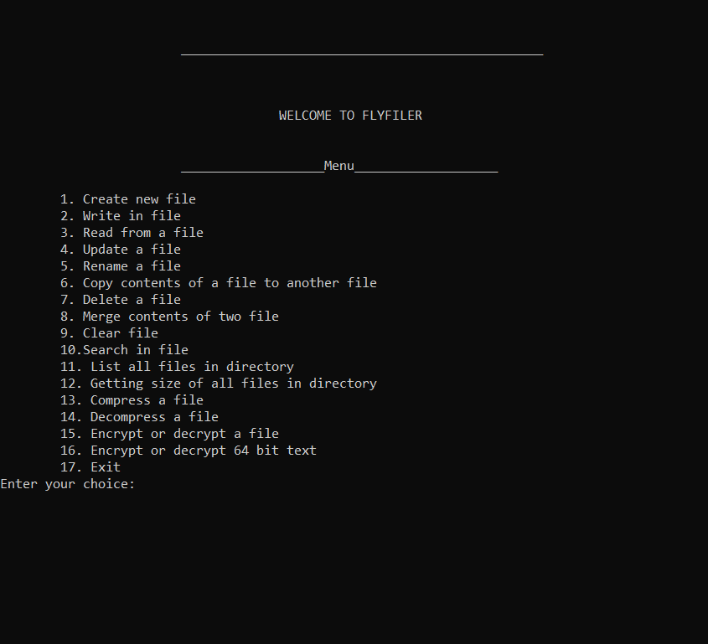
File Related Operations
Accessing from directory
Compression related operations
Encryption related operations

Slide 7
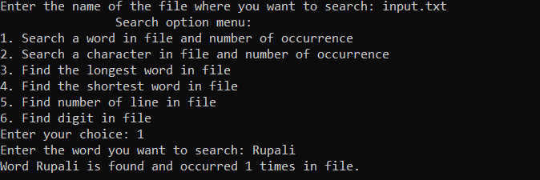
Search options

Slide 8
Motivation behind the project
Important to organize our digital documents.
Assist the user to be more coordinated.
Secured data encryption and decryption feature
Compressing size of text files
Implements almost all the feature necessary to create a digital record of documents.
Suits the criteria of spl-1 because it needs raw coding to a large extent.

Slide 9
Challenges
Encryption decryption algorithm implementation
File compression algorithm implementation
Windows system programming
File operations in details
Faced…

Slide 10
Features Implemented in FlyFiler
Login-Registration Portal
Create New File
Write in File
Read from File

Slide 11
Continued…
Update a File
Rename a File
Copy Contents of File
Text Encryption & Decryption
File Encryption & Decryption
Text File Compression &
Decompression

Slide 12
Continued…
List Files from Directory
Get Size of Directory Files
Clear Contents of File
Merge Contents of two Files
Remove a File

Slide 13
Search Option Menu
Search word and number of occurrences
Search character and number of occurrences
Find longest word in File
Find shortest word in File
Count number of lines in File
Find if any digit in present in File

Slide 14
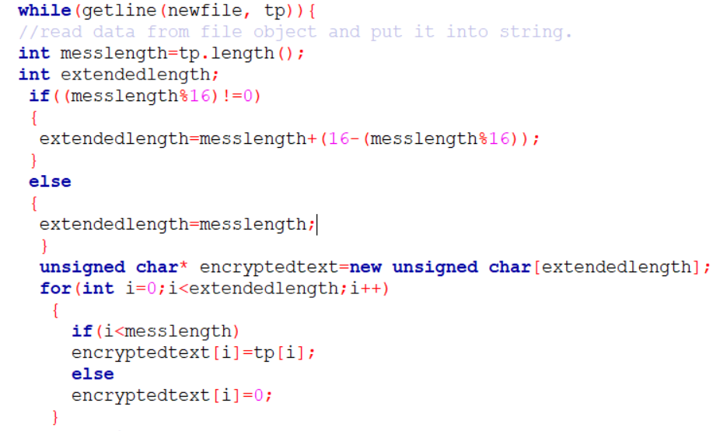
Functions Used

Slide 15
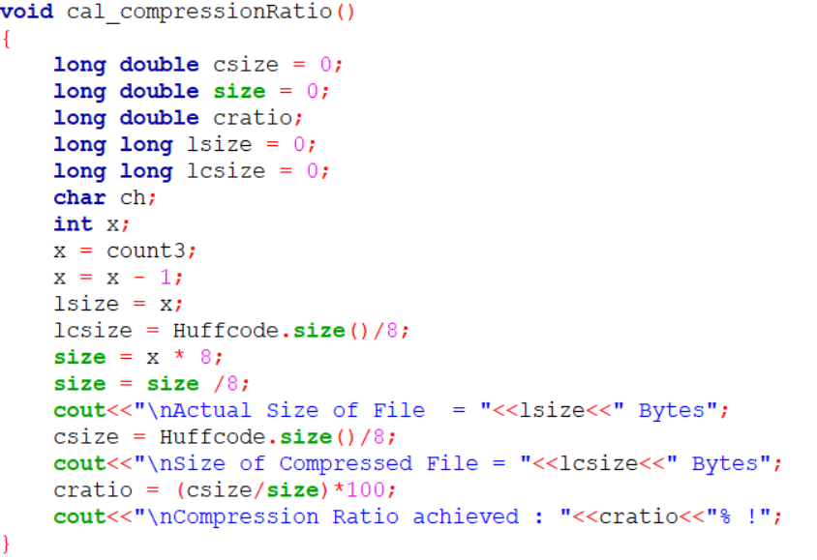
Functions Used

Slide 16
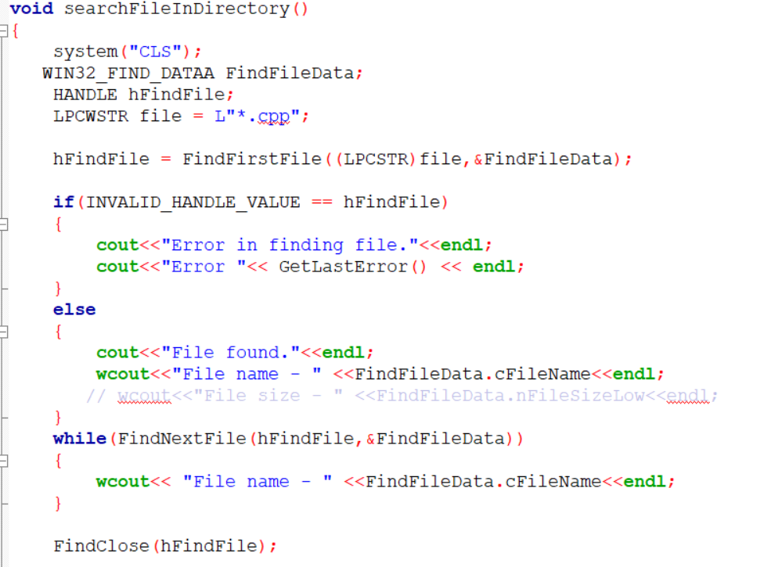
Functions Used

Slide 17
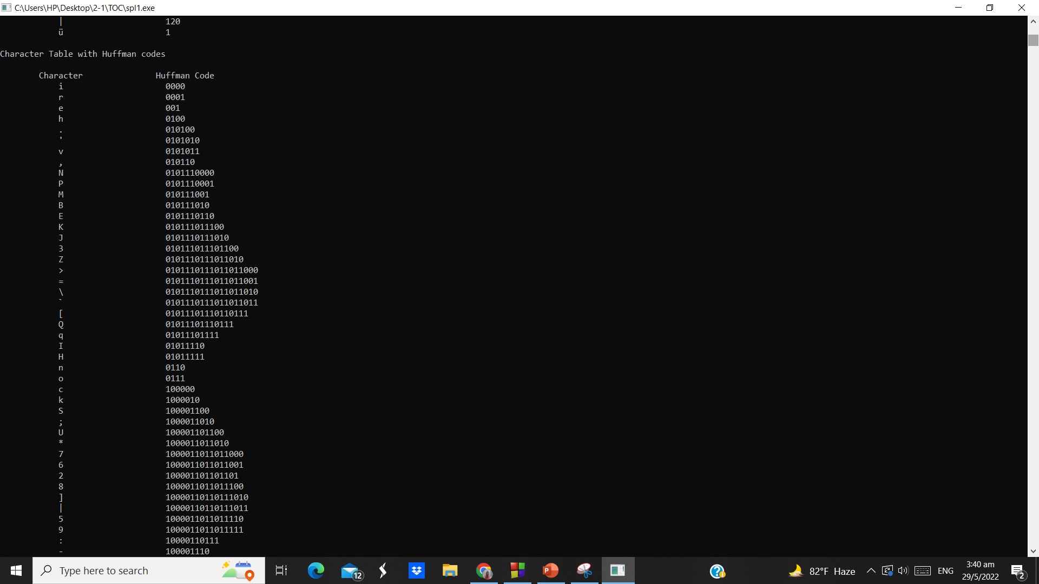
Project Demonstration
Huffman code for each character from file

Slide 18
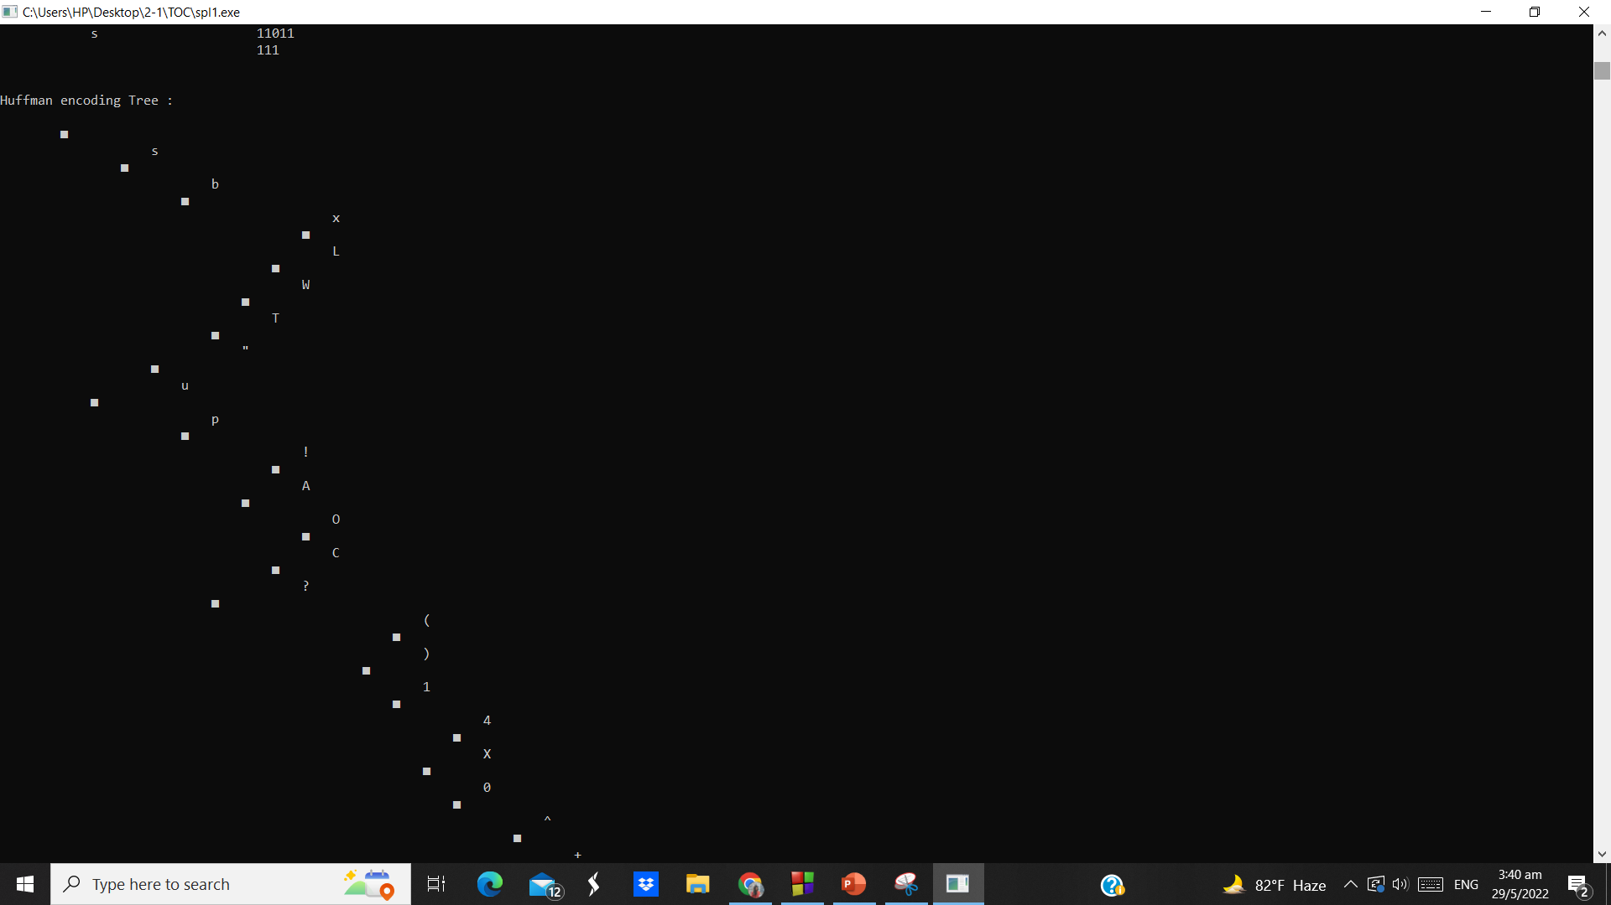
Huffman encoding tree

Slide 19
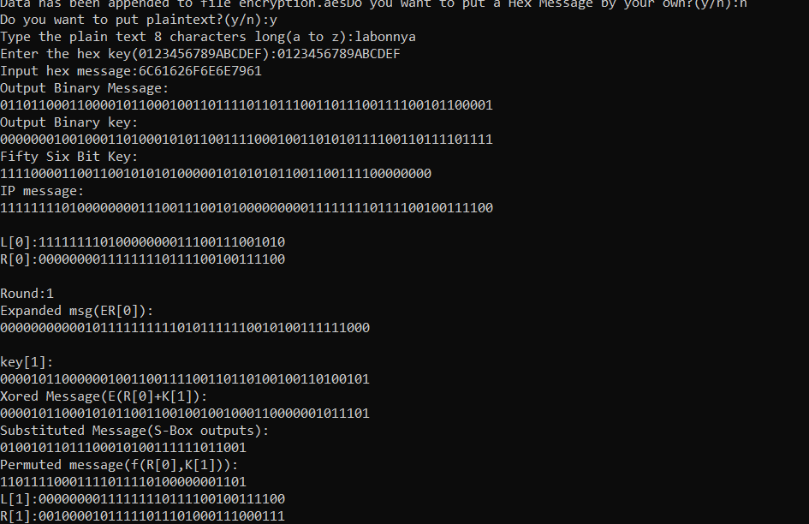
DES Encryption for 64 bits
Fig : DES encryption (64 bits)

Slide 20
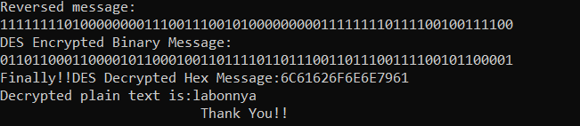
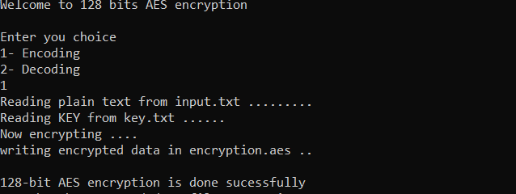
Fig: DES Decryption
AES Encryption
Fig: Text file encryption with AES

Slide 21
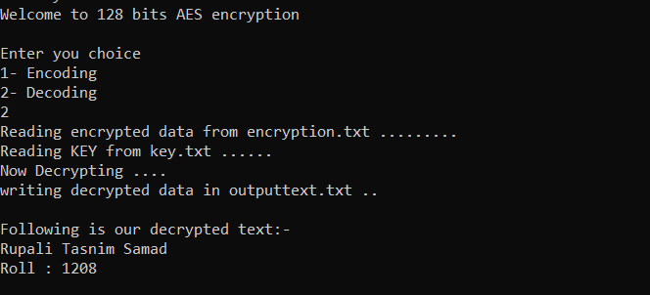
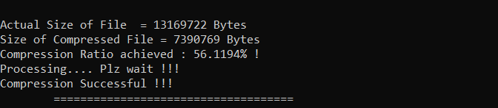
AES Decryption
Compression Ratio

Slide 22
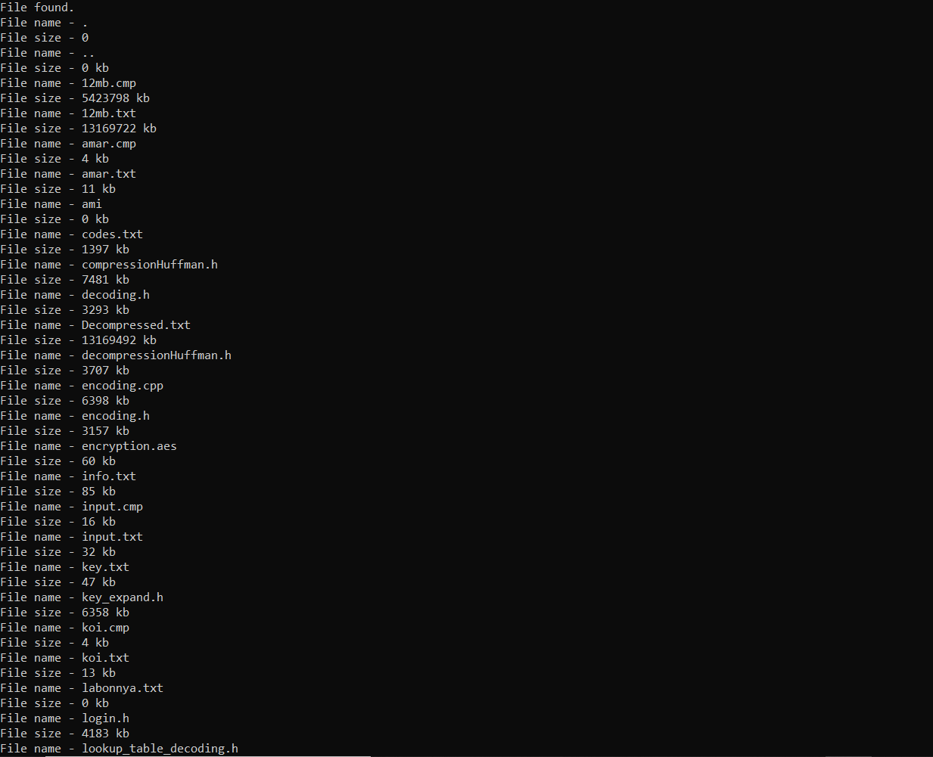
File name and size from directory

Slide 23
Future Scopes
Updating the search menu
Implement Secure Hash Algo
Insert images, bar, charts within text file

Slide 24
GitHub Link for the project -
https://github.com/Labonnya/FlyFiler
Thank you!

